Slide 1
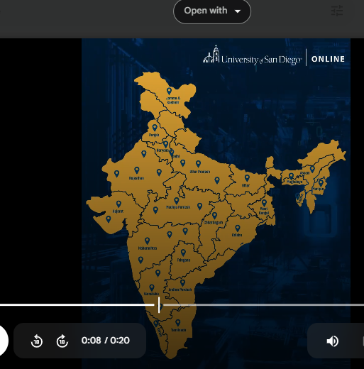


Join the
MS in applied artificial intelligence today!
Give this tag red color and increase the size

Slide 2

We hosted a webinar on “TOPIC”

Slide 3
Names creative

Slide 4
Change the background video
Reduce the duration of the names it is like 11 sec now 0 make it 5-6 seconds fill the names on the single frame.
Join the
MS in applied artificial intelligence today!

Slide 5
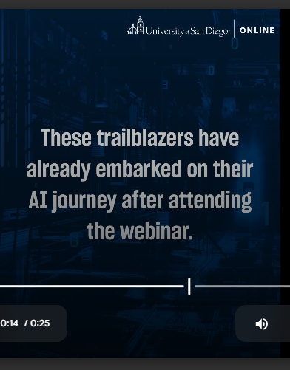
"These trailblazers have kicked off their AI journey by joining the webinar."

